Slide 1
The Regional Transport Office Management
BHAUTIK SUTARIYA - 201506100110096 PROJECT GUIDE
DOLAR BHANDERI - 201506100110097 MR. HARDIK VYAS
Group number:15

Slide 2
Project Definition
We here by declare that the project entitled “The Regional Transport Office Management system ” has been carried out as a group project. This website is a online The Regional Transport Office website through which a user can access The Regional Transport Office information and manage all The Regional Transport Office system.
The system is very useful for the people who apply for license and check The Regional Transport details.

Slide 3
SRS (Software Requirement Specification )
Purpose :-
The System will provide the facility for user to online register in System then apply for learning licenses, driving licenses, check Licenses status, apply for licenses renewal.
User can download Question bank for learning licenses exam and also , Check The Regional Transport Office details.
Users also get information about traffic rules and regulations, traffic signs.

Slide 4
Scope:
Scope of The Regional Transport Office management System User Online Apply Registration, Learning Licenses, Driving Licenses, get The Regional Transport Office details, get Status of Licenses and manage details of Client when they apply for licenses appointment. Presenting information in an easy and Intelligible Manner .it will reduce the difficulties faced on existing system.

Slide 5
Identification of need
A total manual system, which is running without any participation of a computer-definitely have its own disadvantages. We know that the production and use of vehicles are increasing day by day. Hence the need of RTO is very important now days.
To know about the problems specifically, we have done a detailed study on the whole procedure of the system which is currently running.
Intermediate persons & institutions will collect more money for license than it’s fee.
In existing system user can not check his/her license status.
User can not get any type of alert for license.

Slide 6
proposed system
Issue of information’s about license, which include application forms, demo of leaner’s license test and other information's.
Separate account for the license holders and admin.
Proposed system is an online system so any persons can browse the site and apply for learning license.
Avoid intermediate persons and institutions.
Demo questions of learner’s license test will help the users in their license test.
User can check status of license.

Slide 7
Technology Used
Type – Web
Front End – ASP.NET with C# .NET , Ajax.net
Back End – SQL Server
Operating System : Windows
Client Side : HTML , Bootstrap , JQuery

Slide 8
Functional Requirement
1. Customer/Staff Login
2. Customer registration
3. Learning Licenses Appointment
4. Driving Licenses Appointment
5. Generate Learning Licenses Report
6. Get The Regional Transport Office Details
7. Check Status of Licenses

Slide 9
Non Functional Requirement
1. Portable
2. Performance
3. Security
4. Documentation
5. Maintainability

Slide 10
Modules
Login
Including Login management of different users. User Creation of different users. Provide change Password option for users.
Learning Licenses
In Learning Licenses module include the fill the form for learning license and apply for learning license.
Driving Licenses
In Driving Licenses module learner can apply for driving Licenses.
Generate Report of Learning Licenses
In Generate Report Learning Licenses module a PDF will be generated with user details if submit learning licenses form.

Slide 11
The Regional Transport Office Details
In The Regional Transport Office Details Module user easily search all Regional Transport Office Details state wise.
Verification by admin
In verification by admin Module admin can verify data and change status
of license.

Slide 12
User Characteristics
Administrator
Administrator is power user. He has the power to verify the data entered by the user, processing of data and provide appropriate status of license , managing of
all the user.
Authorized User An authorized user should have a user name and password to access details information from the site excluding for accessing general information about
license status and Personal details. A only authorized user can apply for
learning license and driving license.
Visitor
He is the person who will visit the website and get general information about Regional Transport Office and download question bank.

Slide 13
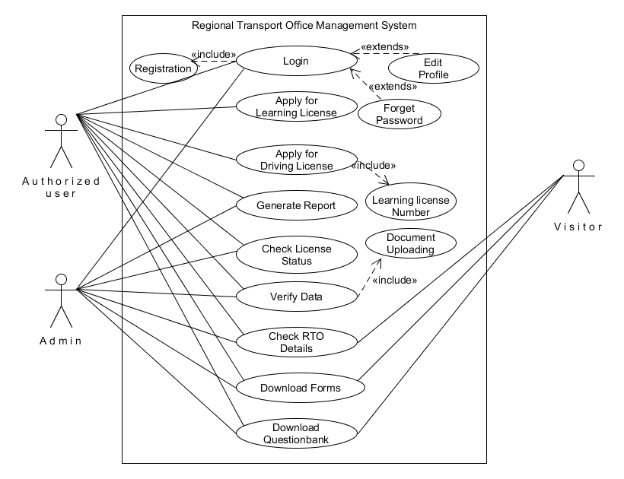
Use case Diagram

Slide 14
Use case Description
Introduction: This use case documents the steps that must be followed in order to be Regional Transport Office management system.
Actors: Administrator Authorized User Visitor
Precondition: The actor must be login in the system before use case begins and it should be valid user.
Postcondition: If user successfully login , application will be submitted and database is updated , else system state remain unchanged.
Event Flow Basic Flow: User login into the system. Display Learning license and Driving license form. If all data submitted value should be inserted into database. Report will be generated. User check license status.
Alternative flow 1: unauthorized user If the system does not validate the user than an error message is flag and the use case returns to the beginning of the flow. Alternative Flow 2 : Learning License This allow user to apply for Learning License and data should be inserted. Alternative Flow 3 : Driving License This allow user to apply for Driving License and data should be Inserted. Alternative Flow 4 : Regional Transport Office Details This allows the user to check Regional Transport Office Details by state wise. Alternative Flow 5 : User exit This allows the user to exit any time during the use case. The use case ends.
Special requirement None
Associated use case Login , Vehicle Registration

Slide 15
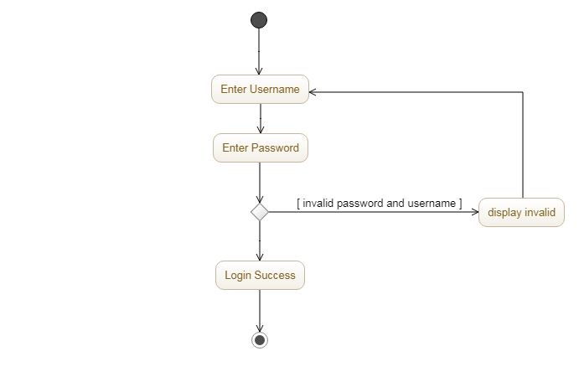
Activity Diagram
Login

Slide 16
Activity | Description
Login | This UML describe login activity for admin, authorized user. It required valid username and password

Slide 17
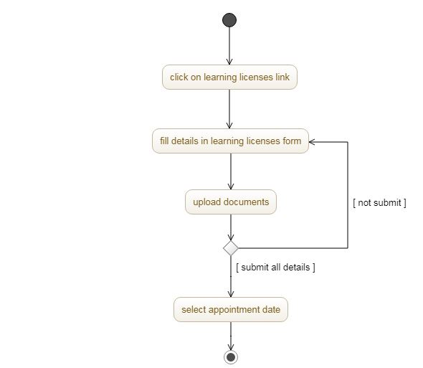
2. Learning License

Slide 18
Activity | Description
Learning Licenses | This UML describe authorized user can get learning licenses form, fill up all details and also get learning licenses appointment date.

Slide 19
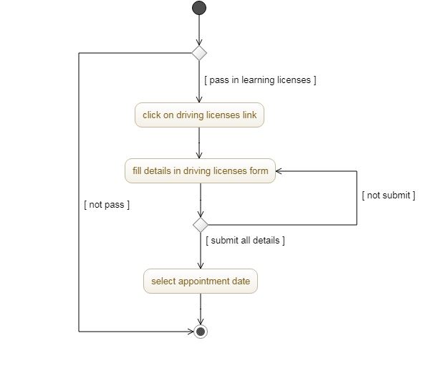
3. Driving License

Slide 20
Activity | Description
Driving Licenses | This UML describe authorized user can get Driving licenses form, fill up all details and also get Driving licenses appointment date.

Slide 21
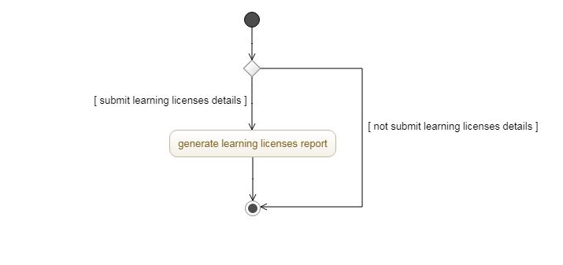
4. Generate Learning Licenses Report

Slide 22
Activity | Description
Generate Learning Licenses Report | This UML describe authorized user can get learning licenses report.

Slide 23
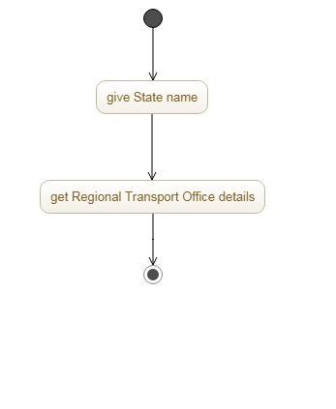
5. Regional Transport Office details

Slide 24
Activity | Description
Regional Transport Office details | This UML describe admin , visitor, Authorized user can get information about Regional Transport Office.

Slide 25
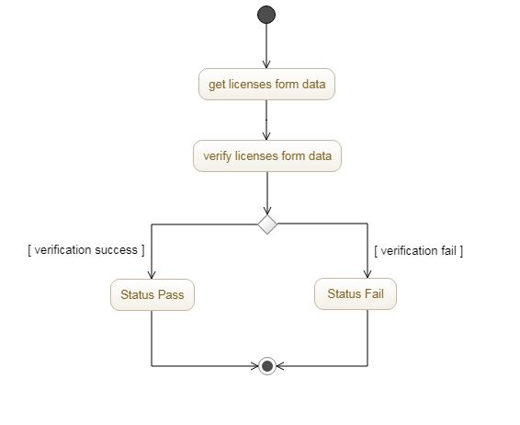
6. Admin verification

Slide 26
Activity | Description
Admin verification | This UML describe admin verify licenses form data and change Status pass and fail.

Slide 27
Data Dictionary 1. Register
Column name | Description | Data type | Width/size | Constrain
User_ID | Id of every user | Int | 16 bit | Primary key
Username | Name of user | Varchar | 20 | Unique constrain
Password | Password of user | Varchar | 20 | Not null
Type | Type of user(admin/user) | Boolean | True/false | Not null

Slide 28
2. Learning Licenses
Column name | Description | Data type | Width/size | Constrain
LL_ID | LL id | Int | 16 bit | Primary key
User_name | Name of user | Int | 16 bit | Foreign key
Fname | First name | Varchar | 15 | Not null
Mname | Middle name | Varchar | 15 | Not null
Lname | Last name | Varhcar | 15 | Not null
Paddress | Permanent address | Varchar | 70 | Not null
Caddess | Commercial address | Varchar | 70 | Not null
Aadhar_Card | Number of aadhar card | Varchar | 12 | Not null
DOB | Date of birth | Date |  | Not null
State_ID | Unique id of state | Int | 16 bit | Not null
RTO_ID | Id of RTO | Int | 16 bit | Not null
Relation | Relation type | Int | 16 bit | Not null
R_First_name | First name of relational | Varchar | 15
R_Last_Name | Last name of relational | Varchar | 15

Slide 29
R_Middle_Name | Middle name of Relational | Varchar | 30
Gender | Gender of user | Boolean | True/false | Not null
Mobile_no | Mobile no | Varchar | 13 | Not null
Age | Age of user | Int | 16 bit | Not null
Country_ID | County of user | Int | 16 bit | Not null
City_status | Status of city | Int | 16 bit
Blood_group | Blood group | Varchar | 3
Email | Email | Varchar | 35
Education | Education of user | Varchar | 35 | Not null
Outside_india_month | No of month in india | Int | 16 bit
Outside_india_year | No of year in india | Int | 16 bit
Status | Status of license | Int | 16 bit | Not null
Appointment_date | Date of appointment | Date |  | Not null

Slide 30
3. Driving Licenses
Column name | Description | Data type | Width/Size | Constrain
DL_ID | id of DL | Int | 16 bit | Primary key
LL_ID | Id of LL | Int | 16 bit | Foreign key
User_Name | Name of user | Int | 16 bit | Foreign key
Status | Status of DL | Int | 16 bit | Not null
Appointment_date | Date of appointment | Date |  | Not null

Slide 31
4. FileUpolad
Column name | Description | Data type | Width/Size | Constrain
User_name | Name of user | Int | 16 bit | Foreign key
Address_path | Path of address proof | Varchar | 20 | Not null
Age_path | Path of age proof | Varchar | 20 | Not null

Slide 32
5. Report_log
Column Name | Description | Data Type | Width/Size | Constrain
Report_ID | Id of report | Int | 16 bit | Primary key
User_name | name of user | Varchar | 20 | Foreign key
Report_Date | Date of report | Date |  | Not null
Report_time | Time of report | Time |  | Not null

Slide 33
6.City
Column name | Description | Data Type | Width/Size | Constrain
City_ID | Id of city | Int | 16 bit | Primary key
State_ID | Id of state | Int | 16 bit | Foreign key
City_name | Name of city | Varchar | 15 | Not null

Slide 34
7. STATE
Column name | Description | Data type | Width/Size | Constrain
State_ID | Id of state | Int | 16 bit | Primary key
State_name | Name of state | Varchar | 20 | Not null

Slide 35
8.Country
Column name | Description | Data Type | Width/Size | Constrain
Country_ID | Id of country | Int | 16 bit | Primary ley
Country_name | Name of country | Varchar | 20 | Not null

Slide 36
9.Rto Details
Column name | Description | Data type | Width/Size | Constrain
RTO_ID | Id of rto | Int | 16 bit | Primary key
State_ID | Id of state | Int | 16 bit | Foreign key
City_id | Id of city | Int | 16 bit | Foreign key
Address | Address of RTO | Varchar | 70 | Not null

Slide 37
Test Case

